Slide 1


App Lab Step 3
Welcome back
Getting Computers to <say> things

Slide 2


A warm welcome back
What did we do last week:
Launched our server and put some code on it: 54.76.117.119
Learnt that PHP is a …….. language?
Leant how to print something to screen echo “hello world”;
Played with variables $myname=“Peter”;
Found out how to get the time.
Why was it 1 hour wrong?
When you see a time like this “1404070490” what does it mean?

Slide 3
Lets check if our server is still running?
Someone check http://54.76.117.119
<?php
echo "Hello world";
echo "This is my first variable which is a word: ";
$my_first_variable="Hello World Again";
echo $my_first_variable;
echo "<BR>";
…
?>

Slide 4

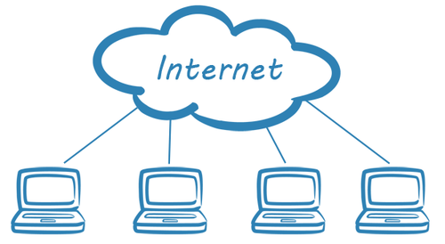
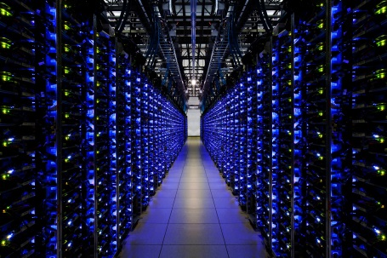

Our server now has a name too
http://54.76.117.119 is a IP address
What's the problem with an IP address?
It now has a name: http://www.dhsapplab.co
http://54.76.117.119
54.76.117.119
http://www.dhsapplab.co
54.76.117.119

Slide 5
Lets check if our new name works?
Someone check http://www.dhsapplab.co
Lets see what IP addresses we have logged:
http://www.dhsapplab.co/access_log.txt

Slide 6
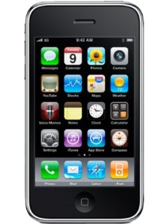

Lets get our server talking?
http://www.dhsapplab.co [GET]
<?php echo "Hello world"; ?>
<say>”Hello”</say>
Call 0203 322 8964
Hear something

Slide 7
Try it
Lets see it
Visit http://www.dhsapplab.co/t1.php
Call 0203 322 8964
What did you hear?

Slide 8
Lets Code t2.php
<?php
# A welcome greeting
$greeting="Welcome to devonshire house app lab";
# A bit of text
$message="The time now is";
# Get the time
$time = time();
# Convert the time into something understandable
$formatted_time = gmdate("H:i:s",$time);
#Goodby message
$goodbye="This app was build by Adrian";
#Lets add our names
header('Content-type: text/xml');
echo "<?xml version='1.0' encoding='UTF-8'?>";
echo "<Response>";
echo "<Say>$greeting</Say>";
echo "<Say>$message</Say>";
echo "<Say>$formatted_time</Say>";
echo "<Say>$goodbye</Say>";
echo "</Response>";
?>

Slide 9
Survey
Scale: 1 2 3 4 5 (where 1 is : no way and 5 is: absolutely)
App lab was interesting and I leant something
If Apps Lab were to continue next term I would like to come along
I would recommend to my friends
Apps lab was really simple and I understood everything
App lab was a bit too tricky and we need to go more slowly
The teacher made the subject exciting
Any other comments ………………………………………………………………………………………………………………………………………………………………………………………………………………………………………………………………………………………………………………………………………………………………………………………………………………………………………………………………………………………………………….

